Slide 1
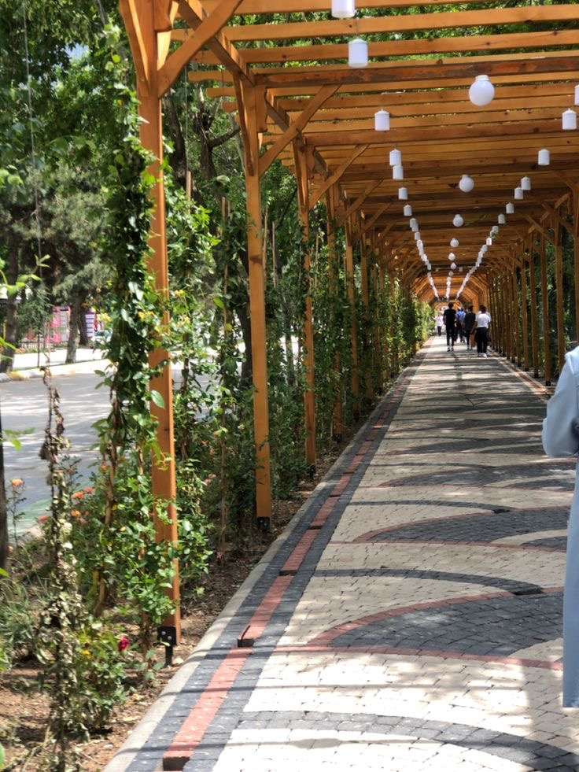
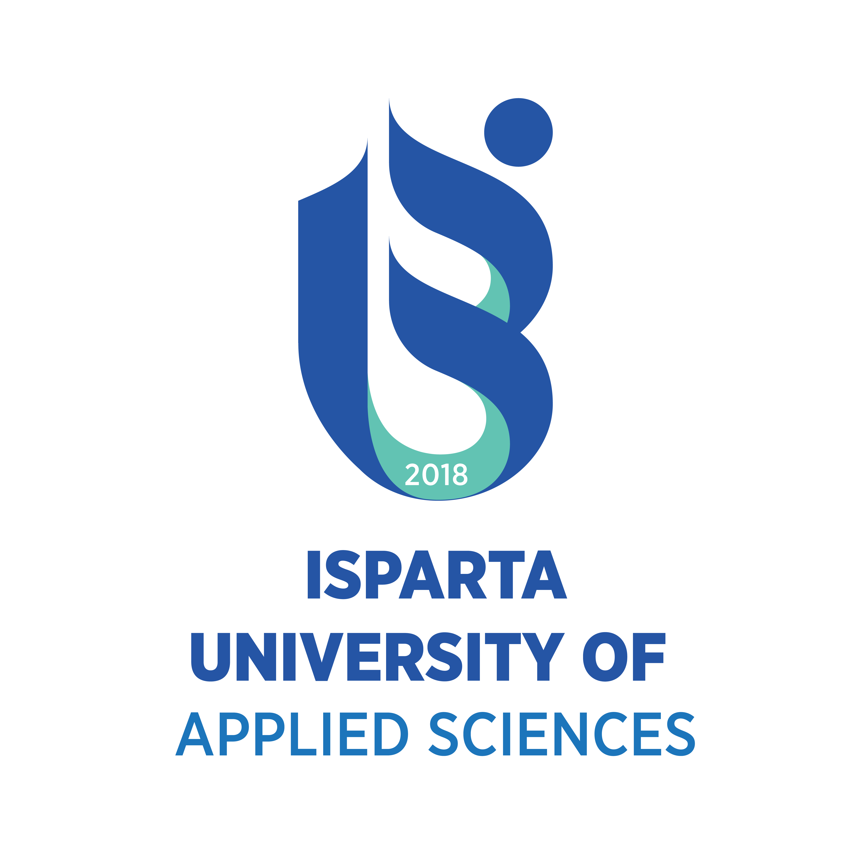

Slide 2
ISPARTA: ‘City of Roses and Lake’
Isparta, renowned for its natural beauty, stands out as one of the most livable cities, excelling in essential services such as education and healthcare.
For students, this welcoming city offers affordable living expenses compared to other cities, along with a safe and secure urban environment.

Slide 3
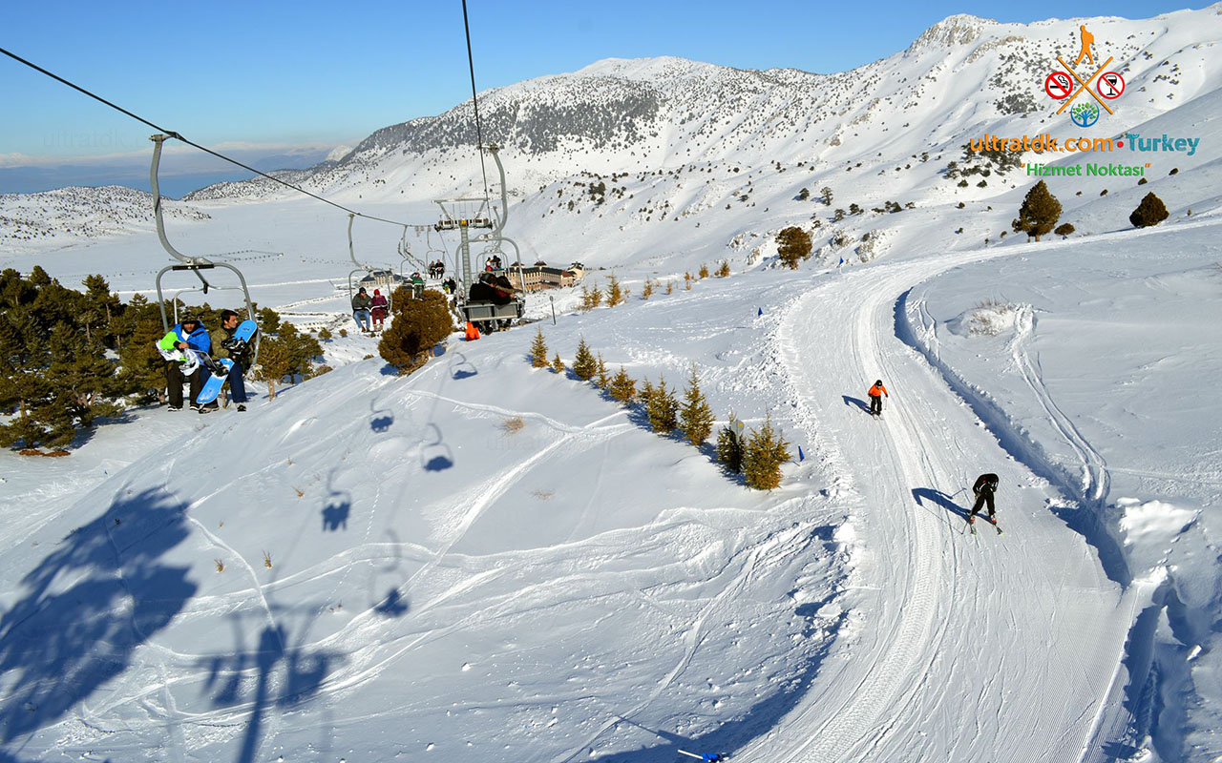
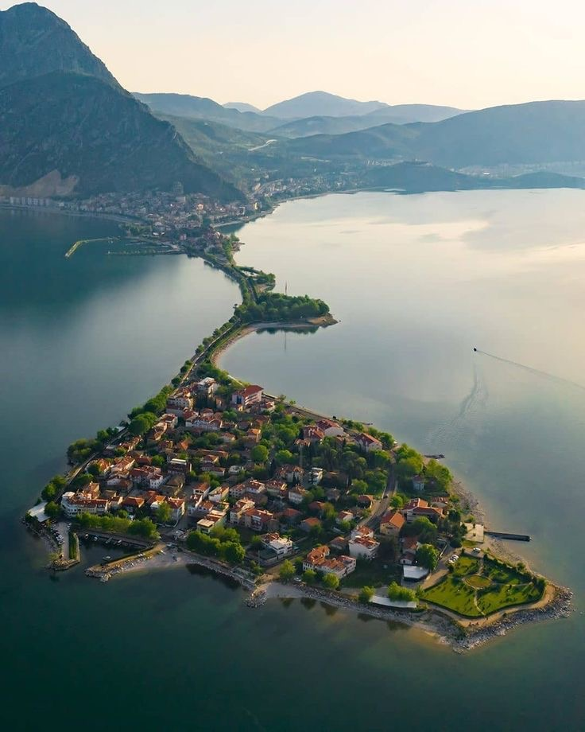
DAVRAZ SKI CENTER
Karlıkaya Winter Sports Tourism is situated 26 km southeast of Isparta.
Davraz Mountain stands prominently between Lake Eğirdir and Lake Kovada.
In addition to skiing, the mountain offers opportunities for other activities such as trekking and various outdoor sports.
LAKE EGIRDIR
Lake Eğirdir, one of Turkey's largest lakes, is famously known as the "Seven Colored Lake" due to its changing colors throughout the day and across seasons.
This internationally significant wetland is recognized as a Drinking Water Reservoir, a Natural Protected Area, and an Important Bird Area.

Slide 4
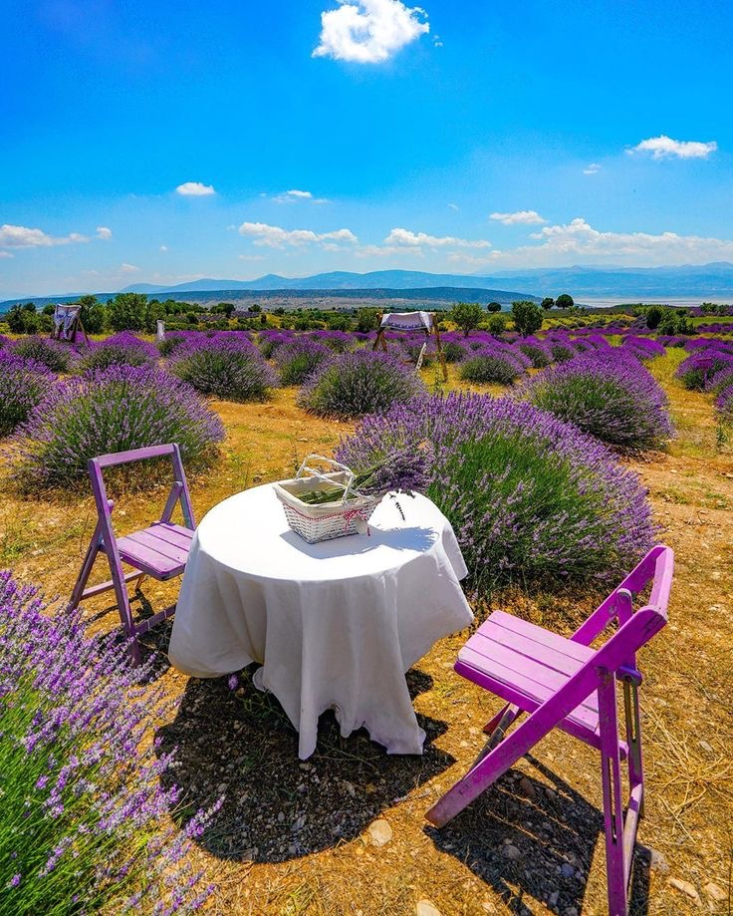
Isparta's rose and lavender gardens are the production hub of Türkiye, playing a vital role in global rose oil production as one of its leading suppliers.

Slide 5
Isparta University of Applied Sciences
Süleyman Demirel University (SDU) and Isparta University of Applied Sciences (IUAS) share numerous infrastructural facilities and are located on the same central campus in the heart of Isparta.
In addition, IUAS extends its educational reach across the entire Isparta region through its vocational schools distributed across the districts.
With a student-centered education system, the university emphasizes performance-oriented job training, equipping its students to excel in the business world.

Slide 6
“7+1 and 3+1 EDUCATION SYSTEM in IUAS”
Isparta University of Applied Sciences has made significant strides in enhancing its students' employability and practical skills through the implementation of its innovative 7+1 (Undergraduate) and 3+1 (Vocational Degree) education systems.
This unique approach combines classroom learning with real-world experience. Under the 7+1 system, students complete seven semesters of coursework, followed by an eighth semester dedicated to internships or practical training in their chosen fields.
This system not only allows students to apply the knowledge they have gained in real-world scenarios but also helps them build strong connections with the industry, potentially leading to future job opportunities.
IUAS aspires to strengthen its reputation as a university that prepares workforce-ready professionals by producing graduates who are not only academically competent but also equipped with the practical skills necessary to excel in their careers.

Slide 7
GENERAL ADMISSION RULES
To enroll in Turkish higher education, Turkish nationals must pass the university entrance exam administered by ÖSYM (www.osym.gov.tr) and achieve a qualifying score in their chosen field.
For full-time enrollment at IUAS, foreign students must have completed their high school education or its equivalent and successfully pass the Foreign Student Examination. The application process also considers high school diplomas and international entrance exams such as the SAT, GMAT, and ABITUR.
EDUCATION SYSTEM
Most courses at IUAS are conducted in Turkish. However, certain graduate programs (e.g., Animal Science) and undergraduate programs (e.g., Tourism Guidance) offer courses in English.
The academic year is divided into two semesters (fall and spring), each lasting 14 to 15 weeks. Many programs also offer weekday morning classes (daytime education).

Slide 8
TUITION
Turkish nationals are exempt from tuition fees at IUAS for the duration of their studies. However, students who enroll in evening education programs or exceed the standard study period are required to pay fees determined by the Council of Higher Education. Foreign national students must pay tuition fees set by the university, with the amount varying based on the area of study.
MINOR AND DOUBLE MAJOR PROGRAMS
IUAS offers students the opportunity to pursue a minor or double major alongside their primary field of study, provided they meet the required criteria. This allows students to earn a second diploma or deepen their academic expertise in a specific area.
SCHOLARSHIP / CREDIT AND WORK OPPORTUNITIES
Turkish nationals can apply for both refundable and non-refundable scholarships or credits offered by various public and private organizations, foundations, associations, and companies. Additionally, IUAS students have the option to work part-time on campus in facilities such as labs and libraries.
Foreign students can also access scholarships from public and private organizations. Outstanding international students may apply for funding through the Türkiye Scholarships program (https://turkiyeburslari.gov.tr).

Slide 9
NATIONAL AND INTERNATIONAL AFFAIRS EXCHANGE PROGRAM
MEVLANA (https://mevlana.isparta.edu.tr)
Turkey manages its own international exchange program called Mevlana, which enables faculty and students to engage in educational and research activities with universities worldwide that have agreements with our university. Similar to Erasmus, faculty members can teach abroad for one or two semesters, and students from partner universities can attend IUAS. (Currently unavailable)
ERASMUS (https://erasmus.isparta.edu.tr)
Through bilateral agreements with esteemed European universities, IUAS offers Erasmus exchange opportunities for both staff and students. These exchanges help students enhance their foreign language skills while gaining valuable professional and scientific experience. Faculty and students from partner institutions also contribute to collaborative scientific and cultural research projects. The maximum duration for staff mobility is two months, and for students, it is twelve months.
FARABİ (https://farabi.isparta.edu.tr)
The Farabi Program allows full-time students to study at other Turkish universities with which IUAS has agreements for one or two semesters. This program aims to provide students with the opportunity to experience education and university life at a different institution in Turkey. (Currently unavailable)

Slide 10
CAMPUS FACILITIES
PROF. DR. HASAN GURBUZ LIBRARY
The Prof. Dr. Hasan Gürbüz Library, located on the main campus, offers an extensive collection of print and electronic books, periodicals, and other resources in Turkish and various foreign languages. To serve the needs of students and staff, the library operates seven days a week.
INFORMATION TECHNOLOGIES
All faculty, staff, and students at Isparta University of Applied Sciences have access to campus-wide internet services. Advanced computer facilities are available in major faculty buildings to support teaching and research activities.
SPORT ACTIVITIES
The central campus offers a wide range of sporting activities for students. It boasts an Olympic-sized swimming pool and one of the largest sports halls in the region. Students and staff can access various indoor and outdoor sports facilities year-round, including tennis, basketball, and football courts.
Additionally, the nearby Davraz Ski Center, the largest in the area, provides excellent opportunities for skiing. Other sports such as badminton, table tennis, handball, and wrestling are also actively promoted on campus.

Slide 11
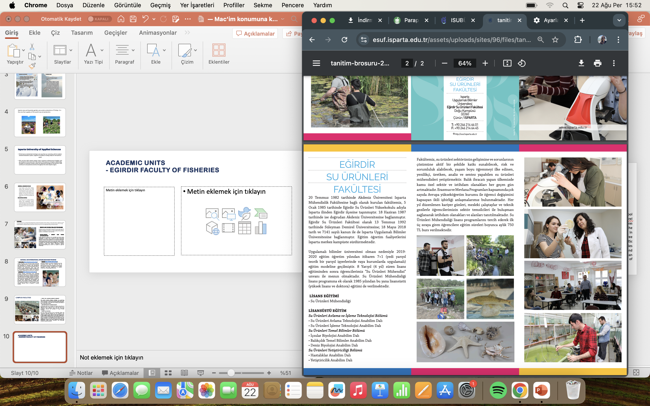
ACADEMIC UNITS
- EGIRDIR FACULTY OF FISHERIES
In 1982, the Faculty of Fisheries was established as an extension of Akdeniz University. In 1992, it became part of Süleyman Demirel University, officially transitioning into a faculty. Initially based in Eğirdir, the faculty later relocated to the core campus in Isparta, where it continues its operations.Since 1985, the faculty has offered a bachelor's degree program in Fisheries Engineering, as well as postgraduate programs (MSc and PhD). The faculty aims to cultivate innovative, productive, and analytical fisheries engineers who embrace lifelong learning and contribute to solving challenges in the aquaculture industry.

Slide 12
BUYUKKUTLU FACULTY OF APPLIED SCIENCES
DEPARTMENTS
International Trade and Business
Banking and Insurance
Accounting and Finance Management
The faculty was originally established in 2010 as the School of Yalvaç Büyükkutlu Applied Sciences and was renamed the Büyükkutlu Faculty of Applied Sciences on June 29, 2020.
With a strong academic foundation and a focus on social sciences, the faculty provides undergraduate education to over 800 students.

Slide 13
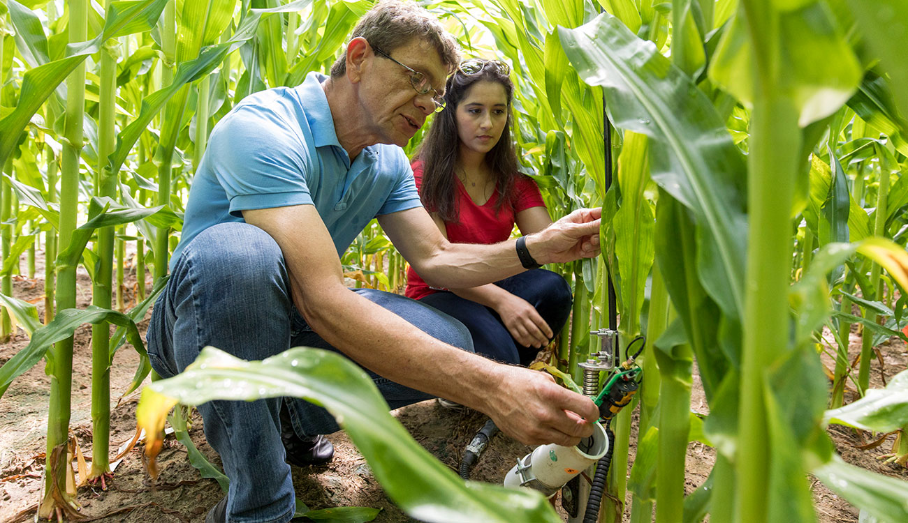
FACULTY OF AGRICULTURE
Departments:
Horticultural Crops
Plant Protection
Field Crops
Soil Science and Plant Nutrition
Animal Science
Agricultural Economics
Agricultural Machinery and Technologies
Agricultural Biotechnology
Agricultural Structures and Irrigation
Established in 1992, the Faculty of Agricultural Sciences and Technologies prepares highly qualified agricultural engineers to meet the needs of both the public and private sectors. With nine departments and state-of-the-art research and development facilities, the faculty is a hub for agricultural innovation and education.Isparta and its surrounding areas are among the largest agricultural centers in Turkey, offering exceptional opportunities for those interested in fruit and vegetable farming. The faculty features 57 laboratories on the central campus and a 1,000-acre Research and Application Farm, providing students with hands-on training and extensive research opportunities.Graduates are well-equipped to pursue careers in marketing, production, and research within Antalya, the Lakes Region, and other parts of the country.

Slide 14
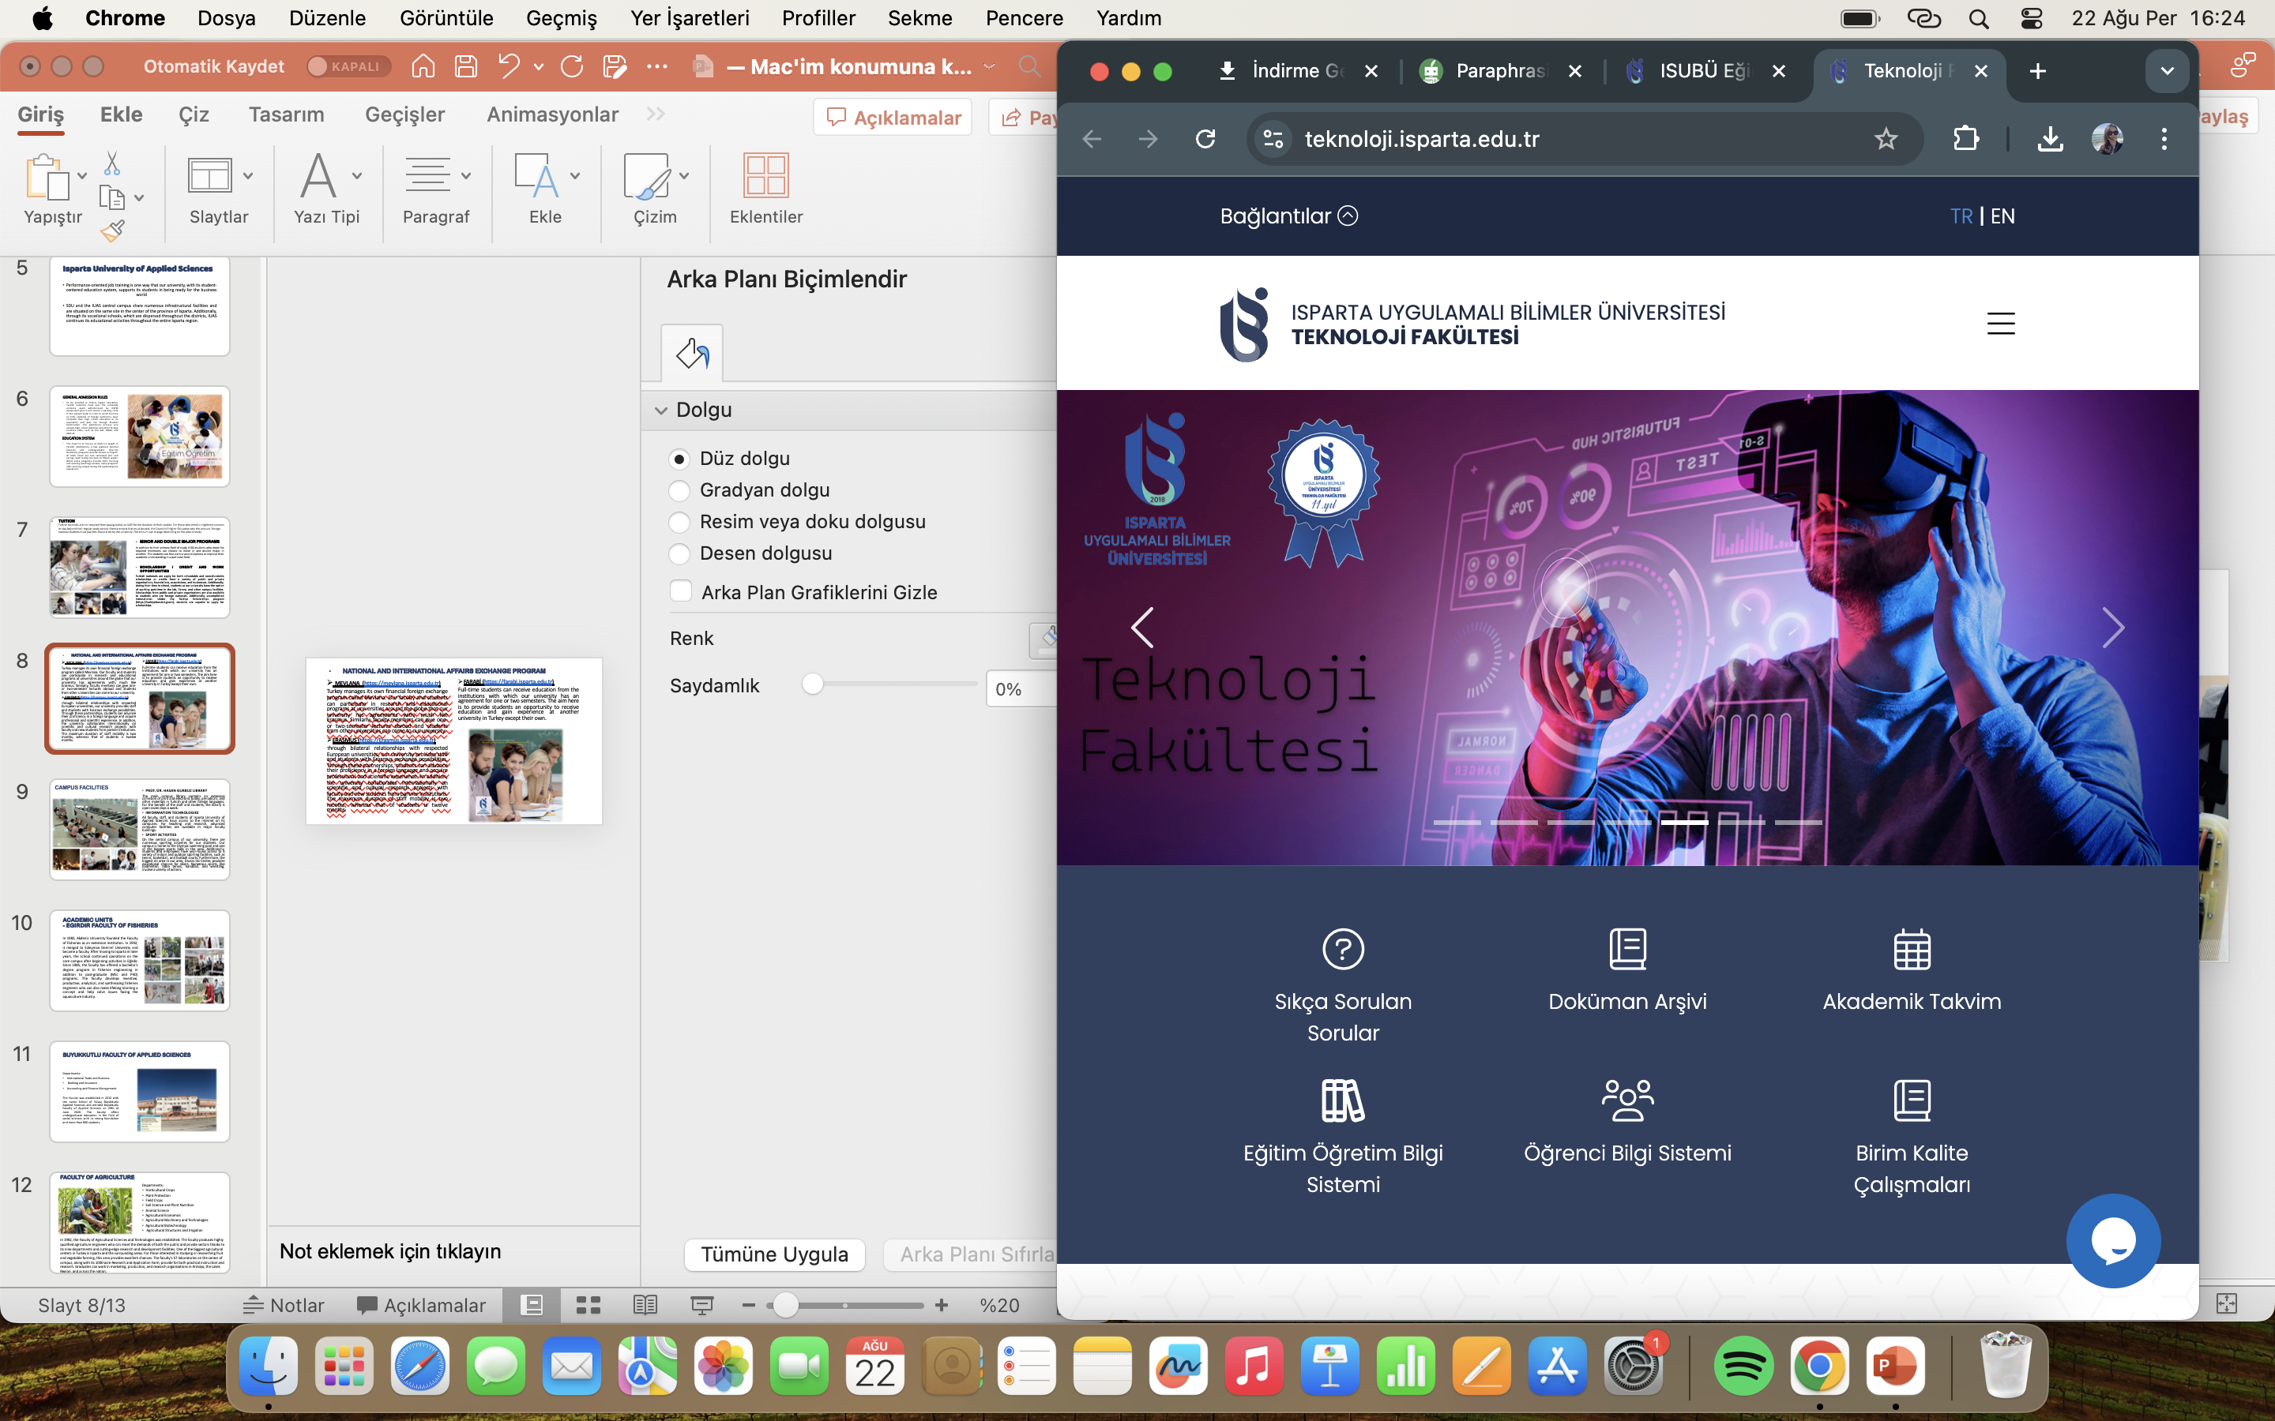
FACULTY OF TECHNOLOGY
Departments:
•Electrical and Electronic Engineering
•Mechanical Engineering
•Civil Engineering
•Mechatronics Engineering
•Biomedical Engineering
•Computer Engineering
The Faculty of Technology, established in 2009, focuses on enhancing engineering vocational and technical education. What sets the faculty apart is its emphasis on producing engineers with advanced practical skills through industry-focused training and a practice-oriented education system. This approach equips graduates with the expertise needed to excel in real-world engineering environments.
At the Faculty of Technology, the focus is on producing engineers who are in demand by employers, rather than engineers who need to search for jobs.Students complete one semester of hands-on practical work at workplaces aligned with their department, ensuring they graduate with up-to-date practical knowledge and skills. Over the course of eight semesters, this integrated approach enables students to gain real-world experience. By working with leading companies in their industries, students are better prepared to seamlessly transition into business life after graduation.

Slide 15
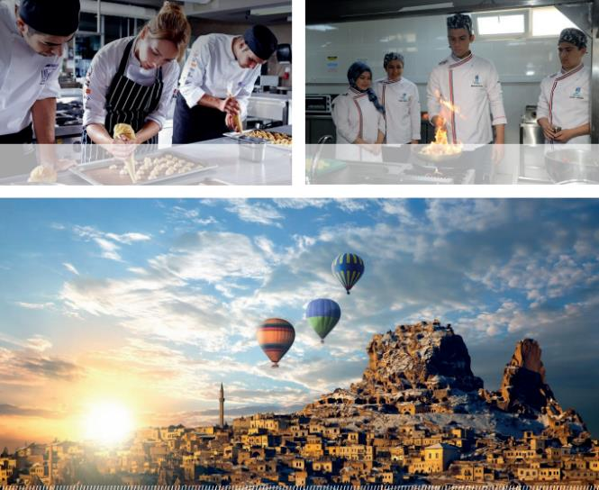
FACULTY OF TOURISM
Departments:
• Tourism Management
• Tourism Guidance
• Gastronomy and Culinary Arts
The Faculty of Tourism traces its origins to the Eğirdir School of Tourism and Hotel Management, founded in 2011. It was officially designated as a faculty in 2019, focusing on excellence in service delivery, research, and education.
The faculty aims to train skilled professionals, including executive candidates, culinary chefs, and tour guides, who can provide enriched experiences to visitors. Graduates are equipped with a deep understanding of Turkey's historical, natural, and cultural heritage, enabling them to offer meaningful and memorable experiences beyond traditional organized tours.

Slide 16
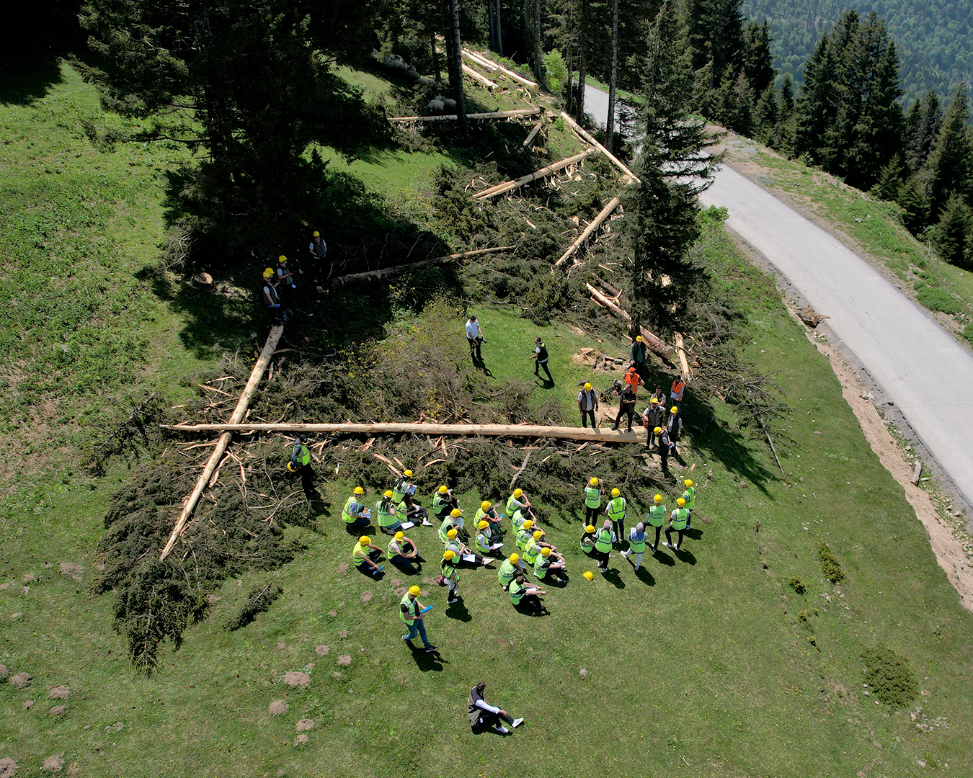
FACULTY OF FORESTRY
Departments:
•Forest Engineering
•Forest Product Engineering
•Wildlife Ecology and Management
Founded in 1992, the Faculty of Forestry educates students in the fields of Forest Engineering, Forest Product Engineering, and Wildlife Ecology and Management. Located in Turkey's Lakes Region, the faculty enhances its academic programs with field trips, providing students with practical, hands-on experiences.
Graduates of Forest Engineering find employment in both the private sector—working in industries such as chipboard, paper, lumber, and furniture production—and in various divisions of the Ministry of Agriculture and Forestry. The Department of Wildlife Ecology and Management, established in 2010, focuses on the conservation and sustainable management of wildlife and natural habitats.

Slide 17
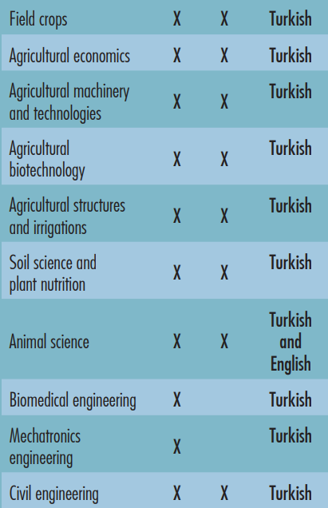
GRADUATE PROGRAMS

Slide 18
LIST OF VOCATIONAL SCHOOLS
Aksu Mehmet Süreyya Demiraslan Vocational School
Banking and Insurance
Human Resources Management
Local Governments
Environmental Protection and Control
Atabey Vocational School
Computer programming
Plant protection
Office Management and Management Assistant
Sapling Breeding
Forestry and Forestry Products
Medicinal Aromatic Plants
Accounting and Tax Applications
Eğirdir Vocational School
Cookery
Office Management and Management Assistant
Food Quality Control and Analysis
Human Resources Management
Accounting and Tax Practices
Tourism and Hotel Management
Gelendost Vocational School
Food Technology
Human Resources Management
Finance

Slide 19
Gönen Vocational School
Banking and Insurance
Office Management and Executive Assistance
Call Center Services
Traditional Handicrafts
Jewelery and Jewelry Design
Architectural Decorative Arts
Fashion Desing
Local Governments
Keçiborlu Vocational School
Banking and Insurance
Computer Programming
Automotive Technology
Civil Aviation Cabin Services
Aircraft Technology
Machine
Interior Design
Isparta Vocational School
Cookery
Banking and Insurance
Foreign Trade
Graphic Design
Public Relations and Publicity
Human Resources Management
Business Administration
Logistics
Accounting and Tax Practices
Marketing
Management of Health Institutions
Tourism and Hotel Management
Senirkent Vocational School
Computer programming
Construction Technology
Logistics
Opticianry
Management of Health Institutions

Slide 20
Sütçüler Prof. Dr. Hasan Gürbüz Vocational School
Hunting and Wildlife
Occupational Health and Safety
Logistics
Finance
Forestry and Forestry Products
Şarkikaraağaç Vocational School
Office Management and Secretaryship
Food Technology
Laboratory and Veterinary Health
Management of Health Institutions
Business Management
Şarkikaraağaç Vocational School of Tourism
Cookery
Vocational School of Technical Sciences
Computer Programming
Biomedical Device Technology
Electricity
Electrical Technology
Photography & Videography
Traditional Handicrafts
Mapping and Cadastre
Construction Technology
Occupational Health and Safety
Machine
Mechatronics
Opticianry
Radio and Television Programming
Transportation and Traffic Services
Building Inspection

Slide 21
Uluborlu Sebahattin Karasoy Vocational School
Biomedical Equipment Technology
Real Estate and Property Management
Disabled Care and Rehabilitation
Graphic Design
Public Relations and Publicity
Mapping and Cadastre
Health Information System Technics
Vocational School of Distance Education
Computer Programming
Office Management and Secretaryship
Services for Call Center
Medical Inventory and Secretary
Yalvaç Vocational School
Cookery
Banking and Insurance
Office Management and Secretaryship
Public Relations and Publicity
Tourist Guidance
Computer Programming
Architectural Restoration
Building Inspection
Yalvaç Vocational School of Technical Sciences
Electrical Energy Production Transmission and Distribution
Building Inspection
Architectural Restoration
Program of Computer Programming
Yenişarbademli Vocational School
Hunting and Wildlife
Forestry and Forestry Products

Slide 22
2020-20243 | Number of Students
Associate’s Degree
Bachelor’s Degree
Mater’s Degree
Doctarate’s Degree
Total
Table1. General number of student in the IUAS
2020-2023 | Number of international students
Associate’s Degree
Bachelor’s Degree
Master’s Degree
Doctarate’s Degree
Total
Table2. number of foreign student in the IUAS

Slide 23

COUNTRIES OF KA131 ERASMUS
Germany
Bulgaria
Czechia
Croatia
Holland / Netherlands
France
Spain
Portugal
Serbia
Italy
Latvia
Lithuanian
Slovakia
Hungary
Malta
Poland
Romania
Greece
Macedonia (north)
*IUAS currently has more than seventy KA131 agreements.
Our number of agreements continues to increase steadily.

Slide 24
COUNTIRES OF MEMORANDUM OF UNDERSTANDING (MoU)
Azerbajian
Bosnia-Herzegorina
Brazil
Ethiopia
Iraq
Kazakhistan
Kosovo
Latvia
Macedonia
Malaysia
Moldova
Pakistan
Philippines
Somalia
Thailand
Uzbekistan
Indonesia
IUAS has agreements of MoU with nearly 50 universities.

Slide 25


